Slide 1
Chapter 11: File System Implementation

Slide 2
Chapter 11: File System Implementation
File-System Structure
File-System Implementation
Directory Implementation
Allocation Methods
Free-Space Management
Efficiency and Performance
Recovery
NFS
Example: WAFL File System

Slide 3
Objectives
To describe the details of implementing local file systems and directory structures
To describe the implementation of remote file systems
To discuss block allocation and free-block algorithms and trade-offs

Slide 4
File-System Structure
File structure
Logical storage unit
Collection of related information
File system resides on secondary storage (disks)
Provided user interface to storage, mapping logical to physical
Provides efficient and convenient access to disk by allowing data to be stored, located retrieved easily
Disk provides in-place rewrite and random access
I/O transfers performed in blocks of sectors (usually 512 bytes)
File control block – storage structure consisting of information about a file
Device driver controls the physical device
File system organized into layers

Slide 5
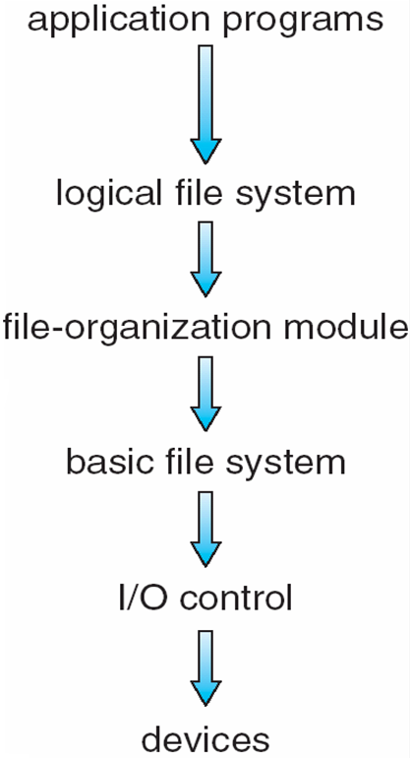
Layered File System

Slide 6
File System Layers
Device drivers manage I/O devices at the I/O control layer
Given commands like “read drive1, cylinder 72, track 2, sector 10, into memory location 1060” outputs low-level hardware specific commands to hardware controller
Basic file system given command like “retrieve block 123” translates to device driver
Also manages memory buffers and caches (allocation, freeing, replacement)
Buffers hold data in transit
Caches hold frequently used data
File organization module understands files, logical address, and physical blocks
Translates logical block # to physical block #
Manages free space, disk allocation

Slide 7
File System Layers (Cont.)
Logical file system manages metadata information
Translates file name into file number, file handle, location by maintaining file control blocks (inodes in Unix)
Directory management
Protection
Layering useful for reducing complexity and redundancy, but adds overhead and can decrease performance
Logical layers can be implemented by any coding method according to OS designer
Many file systems, sometimes many within an operating system
Each with its own format (CD-ROM is ISO 9660; Unix has UFS, FFS; Windows has FAT, FAT32, NTFS as well as floppy, CD, DVD Blu-ray, Linux has more than 40 types, with extended file system ext2 and ext3 leading; plus distributed file systems, etc)
New ones still arriving – ZFS, GoogleFS, Oracle ASM, FUSE

Slide 8
File-System Implementation
We have system calls at the API level, but how do we implement their functions?
On-disk and in-memory structures
Boot control block contains info needed by system to boot OS from that volume
Needed if volume contains OS, usually first block of volume
Volume control block (superblock, master file table) contains volume details
Total # of blocks, # of free blocks, block size, free block pointers or array
Directory structure organizes the files
Names and inode numbers, master file table
Per-file File Control Block (FCB) contains many details about the file
Inode number, permissions, size, dates
NFTS stores into in master file table using relational DB structures

Slide 9
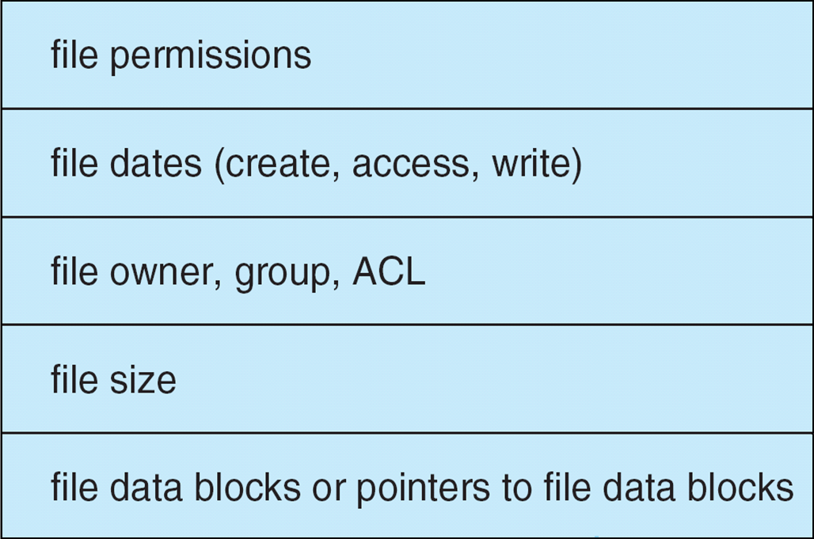
A Typical File Control Block

Slide 10
In-Memory File System Structures
Mount table storing file system mounts, mount points, file system types
The following figure illustrates the necessary file system structures provided by the operating systems
Figure 12-3(a) refers to opening a file
Figure 12-3(b) refers to reading a file
Plus buffers hold data blocks from secondary storage
Open returns a file handle for subsequent use
Data from read eventually copied to specified user process memory address

Slide 11
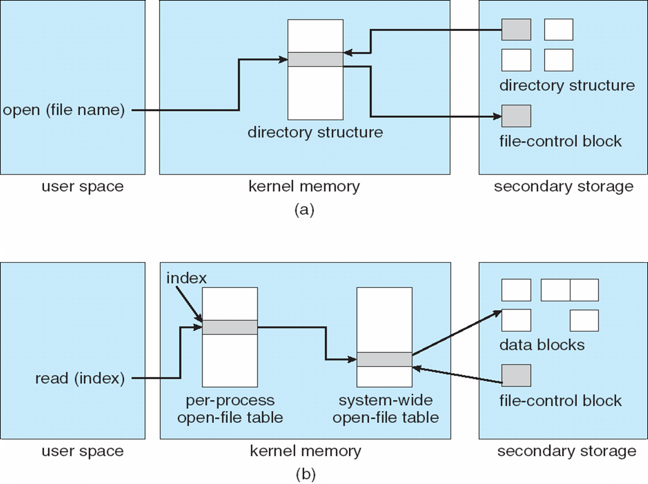
In-Memory File System Structures

Slide 12
Partitions and Mounting
Partition can be a volume containing a file system (“cooked”) or raw – just a sequence of blocks with no file system
Boot block can point to boot volume or boot loader set of blocks that contain enough code to know how to load the kernel from the file system
Or a boot management program for multi-os booting
Root partition contains the OS, other partitions can hold other Oses, other file systems, or be raw
Mounted at boot time
Other partitions can mount automatically or manually
At mount time, file system consistency checked
Is all metadata correct?
If not, fix it, try again
If yes, add to mount table, allow access

Slide 13
Virtual File Systems
Virtual File Systems (VFS) on Unix provide an object-oriented way of implementing file systems
VFS allows the same system call interface (the API) to be used for different types of file systems
Separates file-system generic operations from implementation details
Implementation can be one of many file systems types, or network file system
Implements vnodes which hold inodes or network file details
Then dispatches operation to appropriate file system implementation routines
The API is to the VFS interface, rather than any specific type of file system

Slide 14
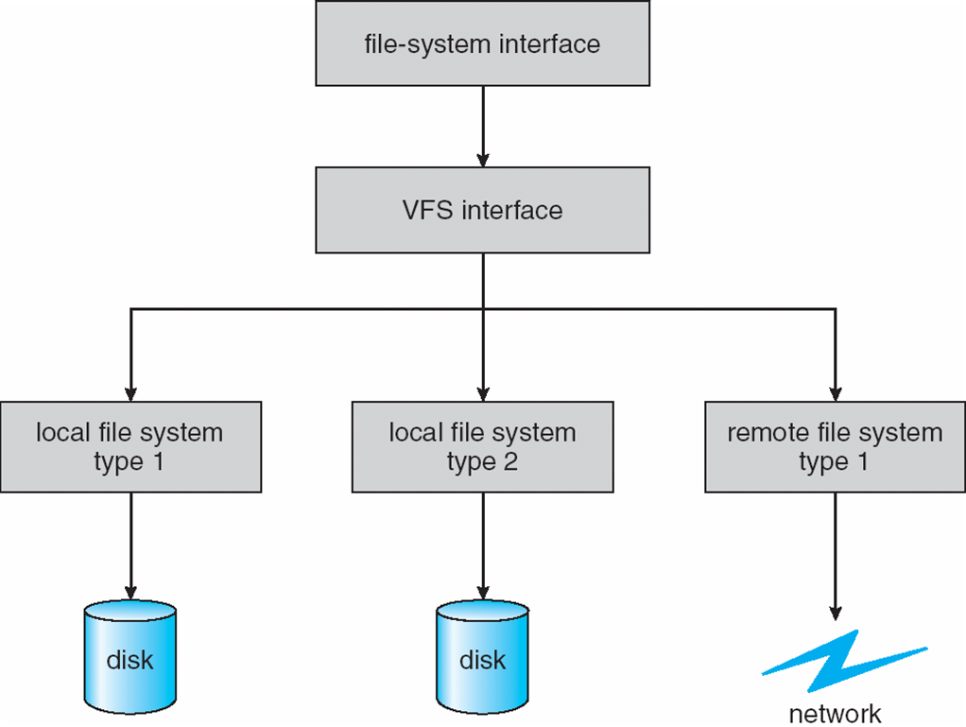
Schematic View of Virtual File System

Slide 15
Virtual File System Implementation
For example, Linux has four object types:
inode, file, superblock, dentry
VFS defines set of operations on the objects that must be implemented
Every object has a pointer to a function table
Function table has addresses of routines to implement that function on that object

Slide 16
Directory Implementation
Linear list of file names with pointer to the data blocks
Simple to program
Time-consuming to execute
Linear search time
Could keep ordered alphabetically via linked list or use B+ tree
Hash Table – linear list with hash data structure
Decreases directory search time
Collisions – situations where two file names hash to the same location
Only good if entries are fixed size, or use chained-overflow method

Slide 17
Allocation Methods - Contiguous
An allocation method refers to how disk blocks are allocated for files:
Contiguous allocation – each file occupies set of contiguous blocks
Best performance in most cases
Simple – only starting location (block #) and length (number of blocks) are required
Problems include finding space for file, knowing file size, external fragmentation, need for compaction off-line (downtime) or on-line

Slide 18
Contiguous Allocation
Mapping from logical to physical
Q
LA/512
R
Block to be accessed = Q + starting address
Displacement into block = R

Slide 19
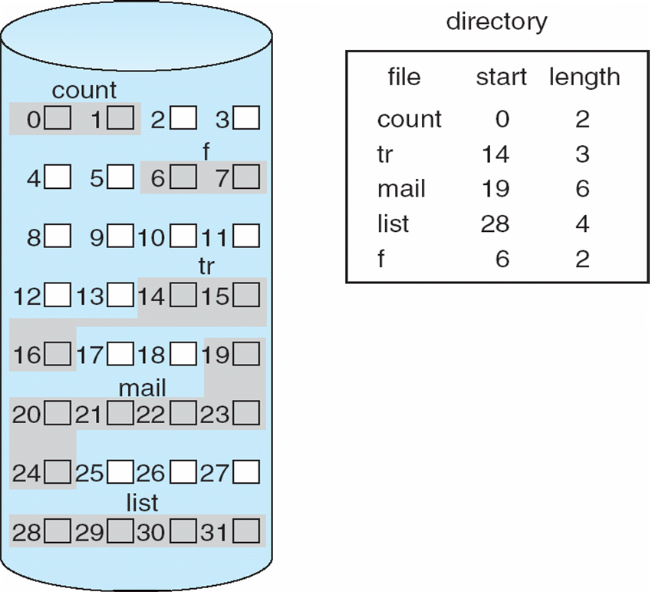
Contiguous Allocation of Disk Space

Slide 20
Extent-Based Systems
Many newer file systems (i.e., Veritas File System) use a modified contiguous allocation scheme
Extent-based file systems allocate disk blocks in extents
An extent is a contiguous block of disks
Extents are allocated for file allocation
A file consists of one or more extents

Slide 21
Allocation Methods - Linked
Linked allocation – each file a linked list of blocks
File ends at nil pointer
No external fragmentation
Each block contains pointer to next block
No compaction, external fragmentation
Free space management system called when new block needed
Improve efficiency by clustering blocks into groups but increases internal fragmentation
Reliability can be a problem
Locating a block can take many I/Os and disk seeks
FAT (File Allocation Table) variation
Beginning of volume has table, indexed by block number
Much like a linked list, but faster on disk and cacheable
New block allocation simple

Slide 22
Linked Allocation
Each file is a linked list of disk blocks: blocks may be scattered anywhere on the disk
block =
pointer

Slide 23
Linked Allocation
Mapping
Q
LA/511
R
Block to be accessed is the Qth block in the linked chain of blocks representing the file.
Displacement into block = R + 1

Slide 24
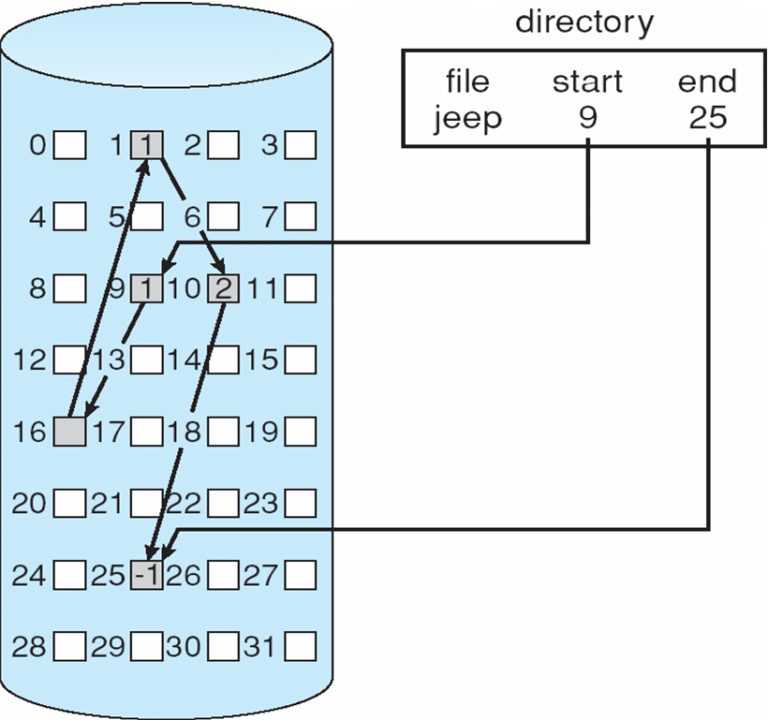
Linked Allocation

Slide 25
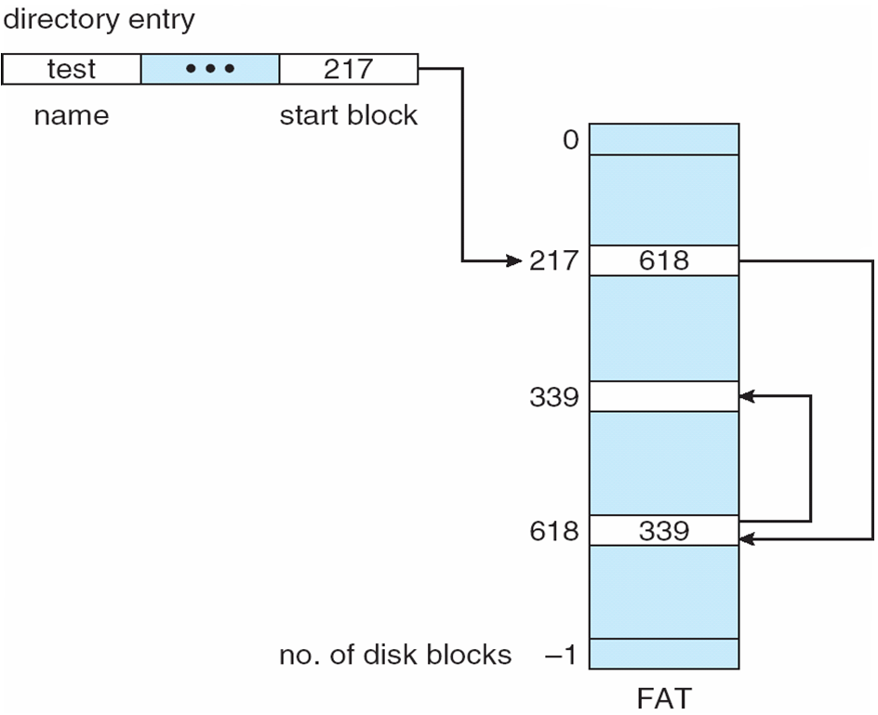
File-Allocation Table

Slide 26
Allocation Methods - Indexed
Indexed allocation
Each file has its own index block(s) of pointers to its data blocks
Logical view
index table

Slide 27
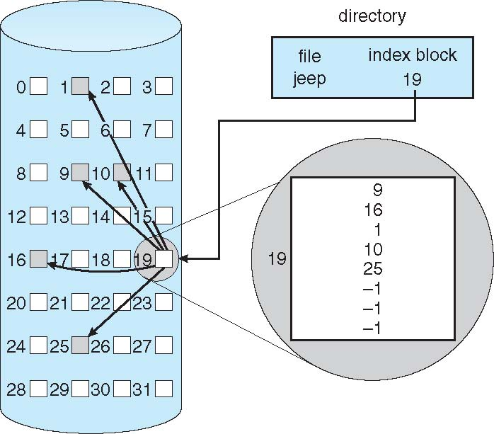
Example of Indexed Allocation

Slide 28
Indexed Allocation (Cont.)
Need index table
Random access
Dynamic access without external fragmentation, but have overhead of index block
Mapping from logical to physical in a file of maximum size of 256K bytes and block size of 512 bytes. We need only 1 block for index table
Q
LA/512
R
Q = displacement into index table
R = displacement into block

Slide 29
Indexed Allocation – Mapping (Cont.)
Mapping from logical to physical in a file of unbounded length (block size of 512 words)
Linked scheme – Link blocks of index table (no limit on size)
Q₁
LA / (512 x 511)
R₁
Q₁ = block of index table
R₁ is used as follows:
Q₂
R₁ / 512
R₂
Q₂ = displacement into block of index table
R₂ displacement into block of file:

Slide 30
Indexed Allocation – Mapping (Cont.)
Two-level index (4K blocks could store 1,024 four-byte pointers in outer index -> 1,048,567 data blocks and file size of up to 4GB)
Q₁
LA / (512 x 512)
R₁
Q₁ = displacement into outer-index
R₁ is used as follows:
Q₂
R₁ / 512
R₂
Q₂ = displacement into block of index table
R₂ displacement into block of file:

Slide 31
Indexed Allocation – Mapping (Cont.)

outer-index
index table
file

Slide 32
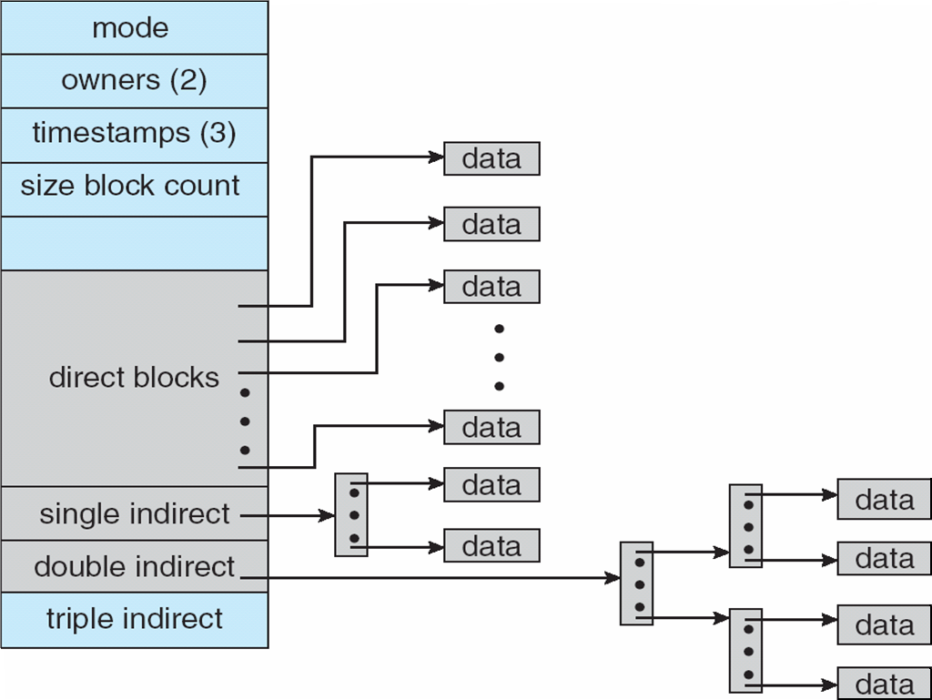
Combined Scheme: UNIX UFS (4K bytes per block, 32-bit addresses)
Note: More index blocks than can be addressed with 32-bit file pointer

Slide 33
Performance
Best method depends on file access type
Contiguous great for sequential and random
Linked good for sequential, not random
Declare access type at creation -> select either contiguous or linked
Indexed more complex
Single block access could require 2 index block reads then data block read
Clustering can help improve throughput, reduce CPU overhead

Slide 34
Performance (Cont.)
Adding instructions to the execution path to save one disk I/O is reasonable
Intel Core i7 Extreme Edition 990x (2011) at 3.46Ghz = 159,000 MIPS
http://en.wikipedia.org/wiki/Instructions_per_second
Typical disk drive at 250 I/Os per second
159,000 MIPS / 250 = 630 million instructions during one disk I/O
Fast SSD drives provide 60,000 IOPS
159,000 MIPS / 60,000 = 2.65 millions instructions during one disk I/O

Slide 35
Free-Space Management
File system maintains free-space list to track available blocks/clusters
(Using term “block” for simplicity)
Bit vector or bit map (n blocks)
0
1
2
n-1
…

1 ⇒ block[i] free
0 ⇒ block[i] occupied
bit[i] =
Block number calculation
(number of bits per word) *
(number of 0-value words) +
offset of first 1 bit
CPUs have instructions to return offset within word of first “1” bit

Slide 36
Free-Space Management (Cont.)
Bit map requires extra space
Example:
block size = 4KB = 2¹² bytes
disk size = 2⁴⁰ bytes (1 terabyte)
n = 2⁴⁰/2¹² = 2²⁸ bits (or 256 MB)
if clusters of 4 blocks -> 64MB of memory
Easy to get contiguous files
Linked list (free list)
Cannot get contiguous space easily
No waste of space
No need to traverse the entire list (if # free blocks recorded)

Slide 37
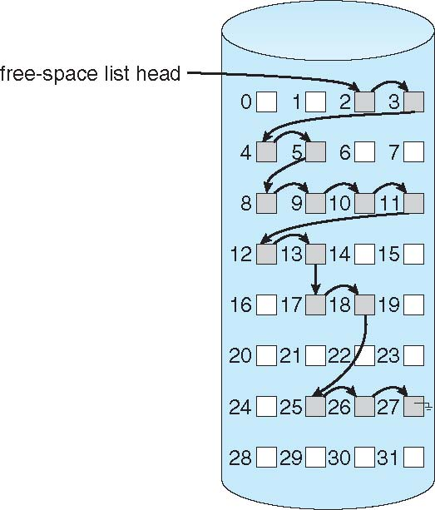
Linked Free Space List on Disk

Slide 38
Free-Space Management (Cont.)
Grouping
Modify linked list to store address of next n-1 free blocks in first free block, plus a pointer to next block that contains free-block-pointers (like this one)
Counting
Because space is frequently contiguously used and freed, with contiguous-allocation allocation, extents, or clustering
Keep address of first free block and count of following free blocks
Free space list then has entries containing addresses and counts

Slide 39
Free-Space Management (Cont.)
Space Maps
Used in ZFS
Consider meta-data I/O on very large file systems
Full data structures like bit maps couldn’t fit in memory -> thousands of I/Os
Divides device space into metaslab units and manages metaslabs
Given volume can contain hundreds of metaslabs
Each metaslab has associated space map
Uses counting algorithm
But records to log file rather than file system
Log of all block activity, in time order, in counting format
Metaslab activity -> load space map into memory in balanced-tree structure, indexed by offset
Replay log into that structure
Combine contiguous free blocks into single entry

Slide 40
Efficiency and Performance
Efficiency dependent on:
Disk allocation and directory algorithms
Types of data kept in file’s directory entry
Pre-allocation or as-needed allocation of metadata structures
Fixed-size or varying-size data structures

Slide 41
Efficiency and Performance (Cont.)
Performance
Keeping data and metadata close together
Buffer cache – separate section of main memory for frequently used blocks
Synchronous writes sometimes requested by apps or needed by OS
No buffering / caching – writes must hit disk before acknowledgement
Asynchronous writes more common, buffer-able, faster
Free-behind and read-ahead – techniques to optimize sequential access
Reads frequently slower than writes

Slide 42
Page Cache
A page cache caches pages rather than disk blocks using virtual memory techniques and addresses
Memory-mapped I/O uses a page cache
Routine I/O through the file system uses the buffer (disk) cache
This leads to the following figure

Slide 43
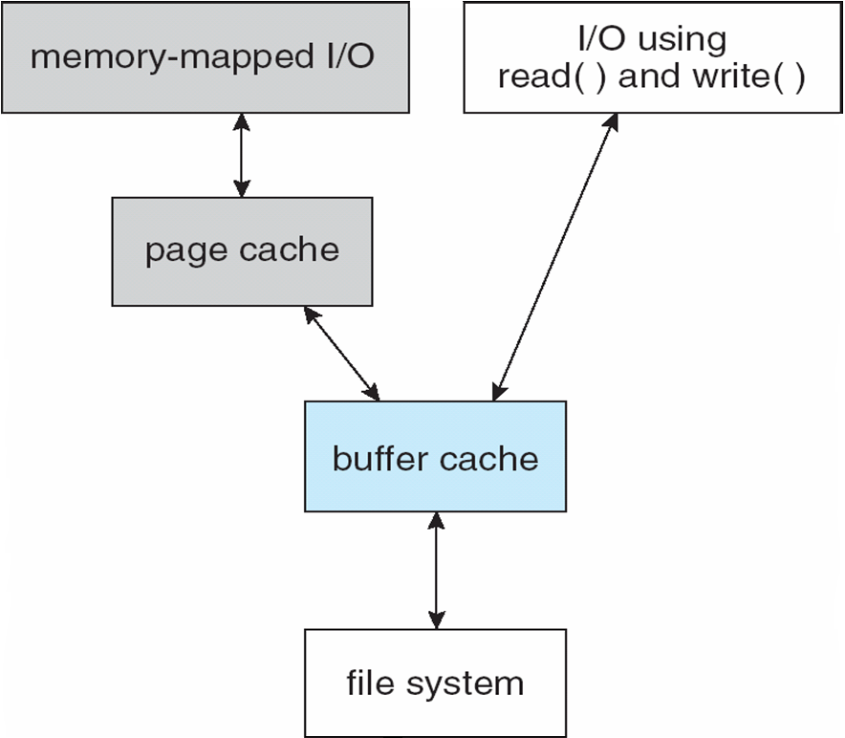
I/O Without a Unified Buffer Cache

Slide 44
Unified Buffer Cache
A unified buffer cache uses the same page cache to cache both memory-mapped pages and ordinary file system I/O to avoid double caching
But which caches get priority, and what replacement algorithms to use?

Slide 45
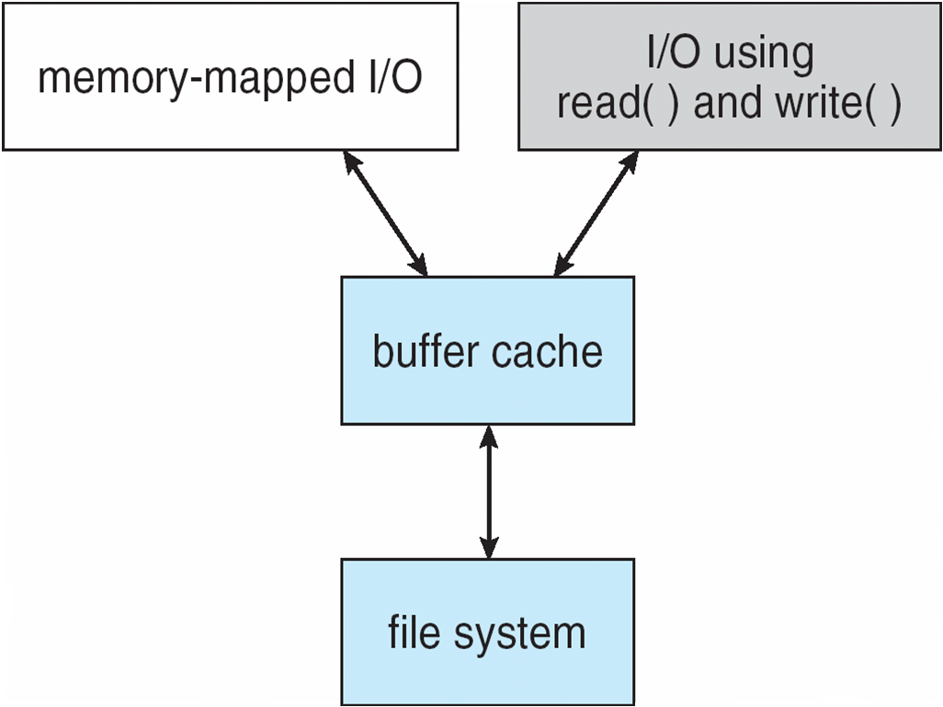
I/O Using a Unified Buffer Cache

Slide 46
Recovery
Consistency checking – compares data in directory structure with data blocks on disk, and tries to fix inconsistencies
Can be slow and sometimes fails
Use system programs to back up data from disk to another storage device (magnetic tape, other magnetic disk, optical)
Recover lost file or disk by restoring data from backup

Slide 47
Log Structured File Systems
Log structured (or journaling) file systems record each metadata update to the file system as a transaction
All transactions are written to a log
A transaction is considered committed once it is written to the log (sequentially)
Sometimes to a separate device or section of disk
However, the file system may not yet be updated
The transactions in the log are asynchronously written to the file system structures
When the file system structures are modified, the transaction is removed from the log
If the file system crashes, all remaining transactions in the log must still be performed
Faster recovery from crash, removes chance of inconsistency of metadata

Slide 48
The Sun Network File System (NFS)
An implementation and a specification of a software system for accessing remote files across LANs (or WANs)
The implementation is part of the Solaris and SunOS operating systems running on Sun workstations using an unreliable datagram protocol (UDP/IP protocol and Ethernet

Slide 49
NFS (Cont.)
Interconnected workstations viewed as a set of independent machines with independent file systems, which allows sharing among these file systems in a transparent manner
A remote directory is mounted over a local file system directory
The mounted directory looks like an integral subtree of the local file system, replacing the subtree descending from the local directory
Specification of the remote directory for the mount operation is nontransparent; the host name of the remote directory has to be provided
Files in the remote directory can then be accessed in a transparent manner
Subject to access-rights accreditation, potentially any file system (or directory within a file system), can be mounted remotely on top of any local directory

Slide 50
NFS (Cont.)
NFS is designed to operate in a heterogeneous environment of different machines, operating systems, and network architectures; the NFS specifications independent of these media
This independence is achieved through the use of RPC primitives built on top of an External Data Representation (XDR) protocol used between two implementation-independent interfaces
The NFS specification distinguishes between the services provided by a mount mechanism and the actual remote-file-access services

Slide 51
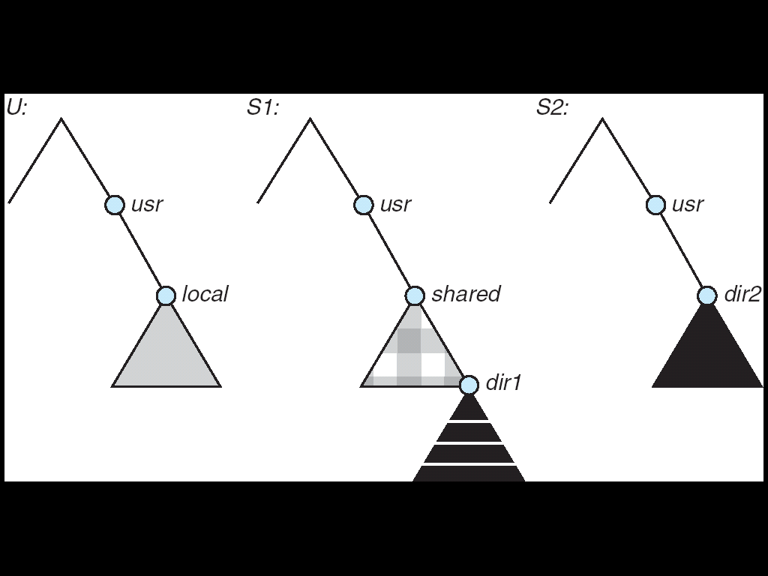
Three Independent File Systems

Slide 52
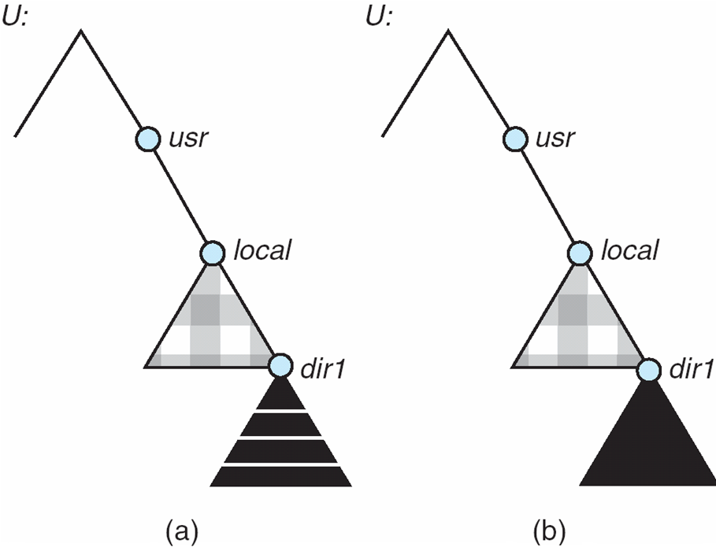
Mounting in NFS
Mounts
Cascading mounts

Slide 53
NFS Mount Protocol
Establishes initial logical connection between server and client
Mount operation includes name of remote directory to be mounted and name of server machine storing it
Mount request is mapped to corresponding RPC and forwarded to mount server running on server machine
Export list – specifies local file systems that server exports for mounting, along with names of machines that are permitted to mount them
Following a mount request that conforms to its export list, the server returns a file handle—a key for further accesses
File handle – a file-system identifier, and an inode number to identify the mounted directory within the exported file system
The mount operation changes only the user’s view and does not affect the server side

Slide 54
NFS Protocol
Provides a set of remote procedure calls for remote file operations. The procedures support the following operations:
searching for a file within a directory
reading a set of directory entries
manipulating links and directories
accessing file attributes
reading and writing files
NFS servers are stateless; each request has to provide a full set of arguments (NFS V4 is just coming available – very different, stateful)
Modified data must be committed to the server’s disk before results are returned to the client (lose advantages of caching)
The NFS protocol does not provide concurrency-control mechanisms

Slide 55
Three Major Layers of NFS Architecture
UNIX file-system interface (based on the open, read, write, and close calls, and file descriptors)
Virtual File System (VFS) layer – distinguishes local files from remote ones, and local files are further distinguished according to their file-system types
The VFS activates file-system-specific operations to handle local requests according to their file-system types
Calls the NFS protocol procedures for remote requests
NFS service layer – bottom layer of the architecture
Implements the NFS protocol

Slide 56
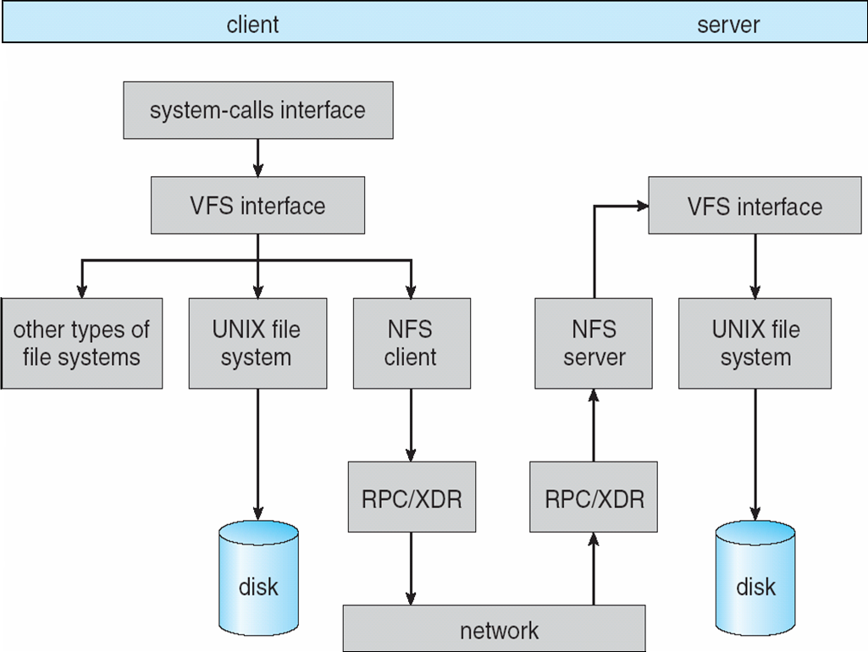
Schematic View of NFS Architecture

Slide 57
NFS Path-Name Translation
Performed by breaking the path into component names and performing a separate NFS lookup call for every pair of component name and directory vnode
To make lookup faster, a directory name lookup cache on the client’s side holds the vnodes for remote directory names

Slide 58
NFS Remote Operations
Nearly one-to-one correspondence between regular UNIX system calls and the NFS protocol RPCs (except opening and closing files)
NFS adheres to the remote-service paradigm, but employs buffering and caching techniques for the sake of performance
File-blocks cache – when a file is opened, the kernel checks with the remote server whether to fetch or revalidate the cached attributes
Cached file blocks are used only if the corresponding cached attributes are up to date
File-attribute cache – the attribute cache is updated whenever new attributes arrive from the server
Clients do not free delayed-write blocks until the server confirms that the data have been written to disk

Slide 59
Example: WAFL File System
Used on Network Appliance “Filers” – distributed file system appliances
“Write-anywhere file layout”
Serves up NFS, CIFS, http, ftp
Random I/O optimized, write optimized
NVRAM for write caching
Similar to Berkeley Fast File System, with extensive modifications

Slide 60
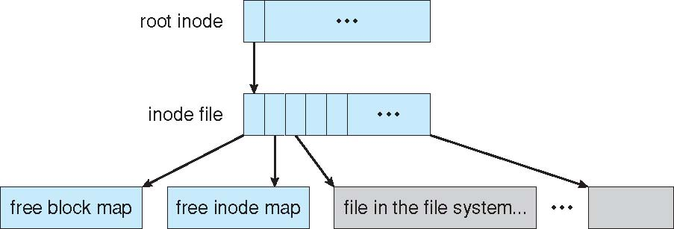
The WAFL File Layout

Slide 61
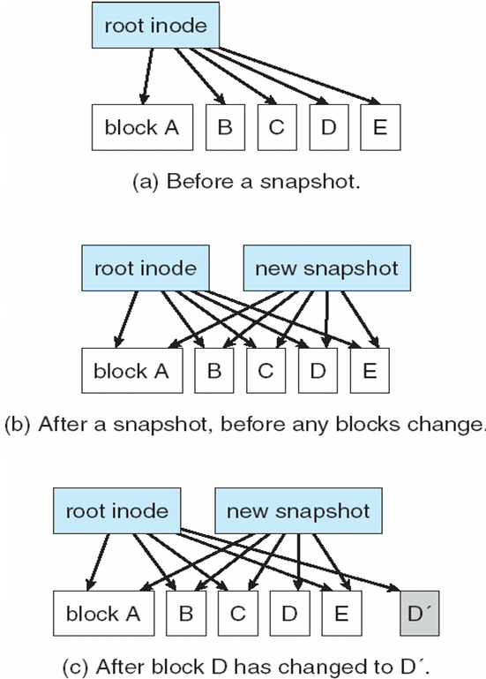
Snapshots in WAFL

Slide 62
End of Chapter 10

Slide 63
Free-Space Management (Cont.)
Need to protect:
Pointer to free list
Bit map
Must be kept on disk
Copy in memory and disk may differ
Cannot allow for block[i] to have a situation where bit[i] = 1 in memory and bit[i] = 0 on disk
Solution:
Set bit[i] = 1 in disk
Allocate block[i]
Set bit[i] = 1 in memory

